Slide 1
Modeling Modeling: Pedagogical Models in Science Education
Luanna Prevost
MSP Workshop
May 18-20, 2015
University of South Florida

Slide 2
Modeling
The process of building, using and evaluating external representations of systems
Authentic science practice
An important constructivist teaching strategy

Slide 3
Why Models?
Can be manipulated
Simplify
Can represent phenomena that are very large or very small
Represent important components
Focus attention
Communicate ideas

Slide 4
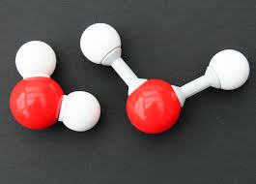

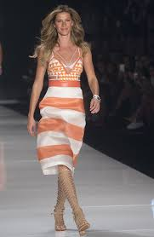
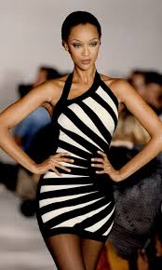
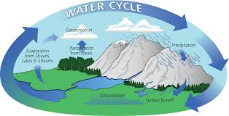
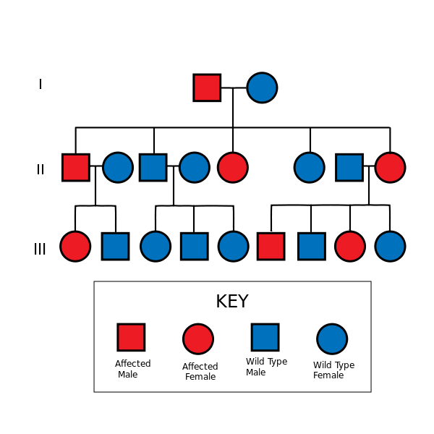
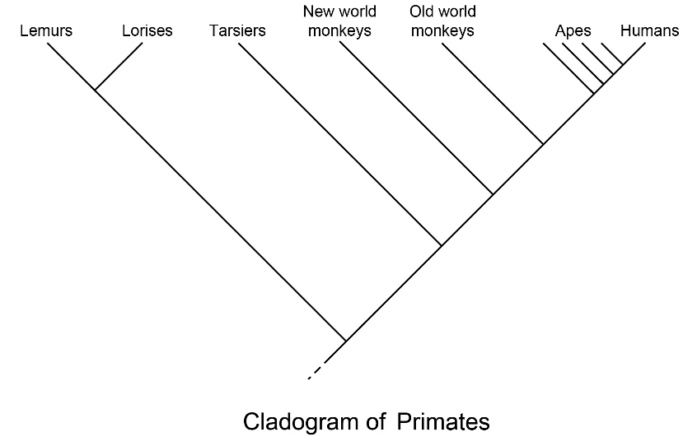
SORT THE MODELS

Slide 5
Pedagogical Scientific Models
Model | Examples
Physical models | Sink hole model; lunar phase model; models of chemicals (atoms & bonds)
Drawings and figures | Food web; photosynthesis; structure-behavior-function models
Graphical representations | Growth curve, Punnett squares
Symbolic models | Chemical formulas
simulations | Phet Simulations https://phet.colorado.edu/en/simulations/category/by-level/middle-school
Mathematical | F=ma; P=VT; r =b-d
More Concrete
More
abstract

Slide 6
Which model type( s) would be appropriate for each of these standards?
SC.7.E.6.1 Describe the layers of the solid Earth, including the lithosphere, the hot convecting mantle, and the dense metallic liquid and solid cores.
SC.8.L.18.2Describe and investigate how cellular respiration breaks down food to provide energy and releases carbon dioxide.
SC.912.L.18.8Identify the reactants, products, and basic functions of aerobic and anaerobic cellular respiration.

Slide 7
Which model category( categories) would be appropriate for each of these cases?
1. Describing the layers of the solid Earth
2. Investigating how cellular respiration breaks down food to provide energy and releases carbon dioxide.
3. Identifying the reactants, products aerobic cellular respiration.

Slide 8
Challenges for students
Separating the model from reality
Selecting the appropriate components
Models may be initially very complex. Practice can help students simplify models
Identifying limitations
When using multiple representations, students may have difficulty translating or relating them
E.g. physical moon phase model, vs. a sketch

Slide 9
Guiding questions
What is the overall process/function that your model explains?
What components are important to your model?
What components are needed to explain this process/function?
What components are represented in the model?
Do the components allow you to explain this process/function?
Do the components allow you to generate hypotheses about this process/function?
What components are not represented in the model?
What are some limitations of the model?
How are these two models similar/different?
What hypothesis can you generate using one model but not the other?
Building Models
Evaluating Models
Comparing Models

Slide 10
References
Dauer, J. T., Momsen, J. L., Speth, E. B., Makohon-Moore, S. C., & Long, T. M. (2013). Analyzing change in students’ gene-to-evolution models in college-level introductory biology. Journal of Research in Science Teaching, 50(6), 639–659.
Harrison, A. G., & Treagust, D. F. (1996). Secondary students’ mental models of atoms and molecules: Implications for teaching chemistry. Science Education, 80(5), 509–534. http://doi.org/10.1002/(SICI)1098-237X(199609)80:5<509::AID-SCE2>3.0.CO;2-F
Harrison, A. G., & Treagust, D. F. (2000). A typology of school science models. International Journal of Science Education, 22(9), 1011–1026. http://doi.org/10.1080/095006900416884
Leenaars, F. A., van Joolingen, W. R., & Bollen, L. (2013). Using self-made drawings to support modelling in science education. British Journal of Educational Technology, 44(1), 82–94.

